Slide 1
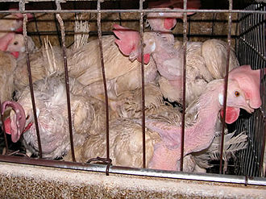
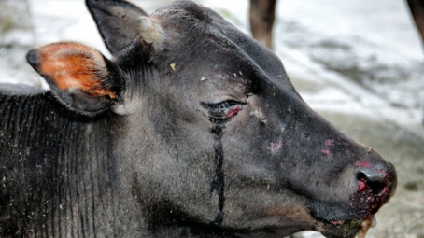
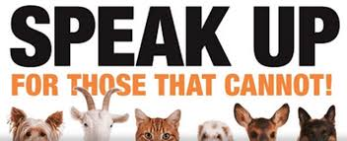
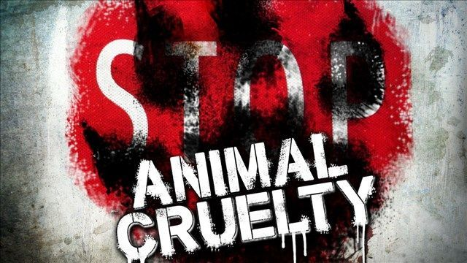
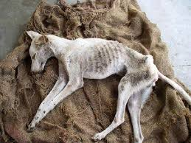
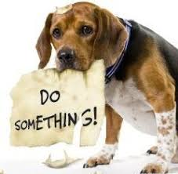
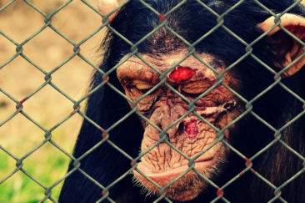
Done by : Aysha Saeed Fatima Saeed Halima Mohamed Hunain school Class : 8.A
Hunting
Animal Cruelty
Hunting was for human survival, but now most people hunt and kill poor animals for leather and luxuries.
Hunters kill more than 200 million animals yearly, I want to know WHY?!.
Effects:
1- Suffering and death.
2- Breaks families apart.
3- Extinction.
People think their vision is right but sadly it’s a big mistake that’s dangerous to our environment.
So please make sure animals are safe!

Slide 2
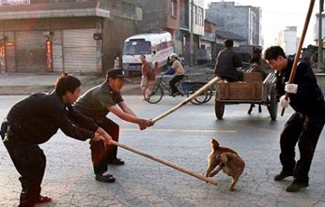
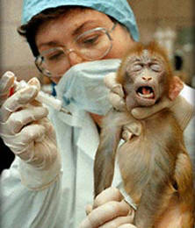
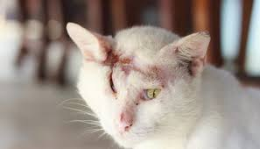
Animal Testing
What is animal cruelty ?
Animal cruelty
Animal cruelty is one of the biggest environmental problems in the world: hunting, animal testing etc. This causes animal extinction; people see the virtual image but not the real image.
Stop animal testing and hunting! Please be careful with decisions you make.
Why torture animals? What did they do to deserve this treatment? Please be friendly and compassionate.
STOP this painful, horrible. Treatment.
People test for food, fur, for their own pleasure!
Think of the animal’s feelings and the future. Your actions will reflect someday.
USA is one of the biggest cosmetics/experiments tested on animals. One example is when they sent monkey’s into space for the first time questioning weather they’ll survive or not. They say monkey’s are similar to humans, and want to see if sending them to space will effect the skin or something; by using telescopes or microscopes. However China’s most common animal testing is on bears.
Let’s make 2018 the year where we end animal testing and make the world a better place for animals!.

